Slide 1
Ku-gaa-gii pimitizi-win:
The COVID-19 cohort study of people experiencing homelessness in Toronto, Canada
Lucie Richard, Dr. Jesse Jenkinson, Olivia Spandier,
Dr. Sharmistha Mishra, Frank Crichlow, and Allison Dyer
PI: Dr. Stephen Hwang
CAEH Conference, November 2nd 2022
This research was supported by the Canadian Institutes of Health Research (CIHR) (FDN-167263 and GA3-177721), and by the Canadian Institutes of Health Research (CIHR) (VR5-173211) in partnership with the Public Health Agency of Canada, through the COVID-19 Immunity Task Force (CITF).
Notes:
Jesse:
Hello everyone, and thank you for joining us. Today we have a full session devoted to the Ku-gaa-gii pimitizi-win study. It is a study with both a quantitative, cohort design portion, and a qualitative portion.
This study was made possible through the support of our funders, the Canadian Institutes of Health Research, and the COVID-19 Immunity Task Force funded in partnership by CIHR and the Public Health Agency of Canada.
The names listed here are of the presenters today, and the Principal Investigator, Dr. Stephen Hwang, but…

Slide 2
Acknowledgements
Ku-gaa-gii pimitizi-win study’s research participants
Survey Research Unit (SRU) staff, including Alexandra Carasco, Annika Khan, and the entire SRU interview team
Shelter and COVID-19 physical distancing shelter hotel staff for facilitating visits
Dr. Suzanne Stewart’s team from the Waakebiness Institute for Indigenous Health
Joe Hester and Harvey Manning from Anishnawbe Health Toronto
Members of MAP’s Community Expert Group (CEG)
Heath Priston and Ryan Nagelmakers from the City of Toronto Shelter Support and Housing Administration (SSHA)
Members of the Gingras Lab including Melanie Delgado-Brand, Tulunay Tursun, Geneviève Mailhot and Roya M Dayam
Jessica Bourke and the Microbiology Lab at Mt. Sinai Hospital
Gary Chao and the Gommerman Lab at the University of Toronto for processing biological samples
Notes:
we want to acknowledge the large number of people involved in this study in numerous ways.

Slide 3
Land acknowledgement
This conference is taking place on land that has been home to First Nations for thousands of years. Toronto exists on the ancestral territory of the Mississaugas of the Credit, the Anishnabeg, the Chippewa, the Haudenosaunee and the Wendat peoples, and is home today to a vast diversity of First Nations, Inuit and Métis individuals from across Turtle Island.
Ku-gaa-gii pimitizi-win:
life is always/forever moving
Notes:
Lucie:
Our team works with and for people experiencing homelessness, a group in which people who identify as Indigenous are over represented when compared to the population of Toronto. For this reason, we have a special responsibility to be mindful of our positioning and privilege when conducting research. We are continuing to learn. As a case in point, you may have noticed that our study name doesn’t match the conference materials. At its onset, this study was called the COVENANT study, a term which was chosen to invoke the idea of a contract or a duty to care for one another. The intention behind the name was positive; but as always, intentions are insufficient when they have the potential to cause harm.
Our valued collaborators at Anishnawbe Health Toronto and Waakebiness-Bryce Institute for Indigenous Health informed us on how this name can be triggering to people who identify as Indigenous, in particular as the term COVENANT has Catholic religious, and therefore colonial, overtones. So, the new name, Ku-gaa-gii pimitizi-win, was given in a spirit naming ceremony by Elder Dylan Courchene from Anishnawbe Health Toronto. Ku-gaa-gii pimitizi-win roughly translates in English to ‘life always/ever moving’, which reflects and honours the movement of homeless individuals across the land, describes the spirit of the land we are on and also the force that connects us all to the future (which I think we may feel more than usual given our collective experience during this pandemic).

Slide 4
Acknowledging Terminology:
People experiencing homelessness
Notes:
Jesse:
We are also mindful that people may identify in different ways. Some identify as unhoused or unsheltered, some as homeless, others as people experiencing homelessness, and others still would prefer not to be grouped but have their unique identity highlighted. Sometimes us academics complicate things too much in an effort to be inclusive, anti-oppressive and respectful, and we end up choosing words or terminology that the very people who we are supporting don’t connect with. We are mindful of this.
We use the term people experiencing homelessness throughout our presentation and writings, but we want to acknowledge that many people identify in different ways. We see that, we hear you, and we acknowledge all of those identities.

Slide 5
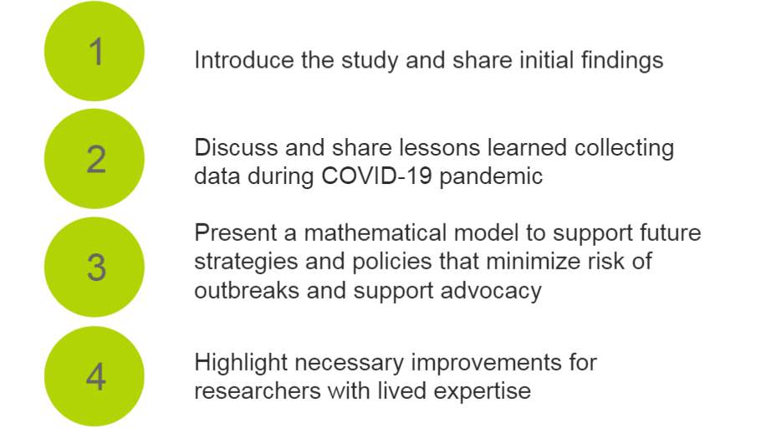
Session Outline
Notes:
Lucie:
At the end of each half there will be a 15-min Q&A.

Slide 6
Part 1 :
Introducing the
Ku-gaa-gii pimitizi-win study
Notes:
Lucie

Slide 7
Motivation for the study
People experiencing homelessness often reside in settings with traits ideal for the spread of COVID-19 (eg. crowded, shared sleeping spaces)
As a group, people who experience homelessness also have higher rates of health conditions associated with poor COVID-19 outcomes
Notes:
Lucie:
From the start of the pandemic, we suspected that COVID-19 would likely put people experiencing homelessness at particular risk, for two reasons. First, people who lack stable housing are more likely to reside in settings with conditions ideal for transmission of infectious disease (for example high levels of crowding and lack of private sleeping spaces). And second, as a group, people experiencing homelessness have higher rates of health conditions we know to be associated with poor outcomes from COVID-19 infection.

Slide 8
Together, these realities mean that COVID-19 poses a threat to the health of people who experience homelessness.
Notes:
Lucie:
Together, these realities mean that COVID-19 poses a threat to the health of people who experience homelessness.

Slide 9
We also know that vaccination is one of the best protections against serious illness from COVID-19 infection, yet early reports suggested that rates of vaccination among people experiencing homelessness might be low.
Notes:
Lucie:
We also know that vaccination is one of the best protections against serious illness from COVID-19 infection, yet early reports in the pandemic suggested that rates of vaccination among people experiencing homelessness might be low.

Slide 10
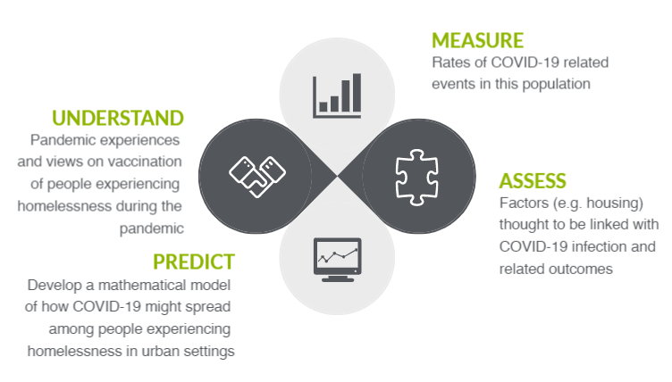
Quant and Qual Study goals
Notes:
Lucie:
While evidence is now starting to come out that confirms that risk for COVID-19 infection and related outcomes among people experiencing homelessness is very real, rather than theoretical, and COVID-19 vaccination rates are looking relatively low, there are very few studies that follow individuals over time to better understand how, when and why infection, vaccination and other related events occur.
So, to fill this important gap in knowledge, Ku-gaa-gii pimitizi-win aims to do 4 interrelated things:
Measure rates of COVID-19 related events
Assess what factors, especially what we call ‘modifiable factors’ like degree of crowding in housing (in other words, things that could theoretically be changed), are linked with infection and outcomes following infection
ETC
To achieve these goals we conducted 1) a cohort study, that I will describe next, and 2) a qualitative study to really get deeper into that ‘Understand’ goal, which Jesse will describe shortly after.

Slide 11
Quantitative Methods
Recruitment: June - September 2021 from 61 shelters and physical distancing hotels across Toronto, and 1 urban encampment
736 individuals: survey and biological samples (blood, saliva) to test for current/past COVID-19 antibodies
Follow up every 3 months over the next year to do additional surveys and sample collection
Notes:
Lucie:
To recap, we needed to follow over time a sample of people experiencing homelessness that was as representative as possible. To generate this sample, then, we recruited from as many homeless shelters and distancing hotels and encampments as possible across Toronto. We managed to recruit from 61 shelter and hotel sites, and from 1 urban encampment between June and Sept 2021 (we wanted to recruit from more than one urban encampment, but those of you from this area will recall that urban encampments were cleared by the city during this period). At each site we recruited only from randomly selected beds or rooms, as applicable, and made sure to recruit an appropriate number from each site so that we didn’t, for example, enroll half of residents of one shelter and none at another.
Over 700 people consented to participate in the study, and proceeded to complete a detailed survey which included questions about things like demographics, health history, behaviours and beliefs related to COVID-19, and a detailed housing history for at least the past 90 days. We also collected saliva and blood samples to detect current COVID-19 infection (basically a PCR test) or evidence of past COVID-19 infection (presence of antibodies). And these samples were essential, as you’ll see later, because COVID-19 very often occurs without our knowledge, this was true even before the province scaled back PCR testing earlier this year.
The participants were then re-contacted and interviewed again every 3-months, approximately, which involved another survey and another sample collection. We just completed the 12-month interviews a few weeks ago, and are now preparing the final interview data for analysis.

Slide 12
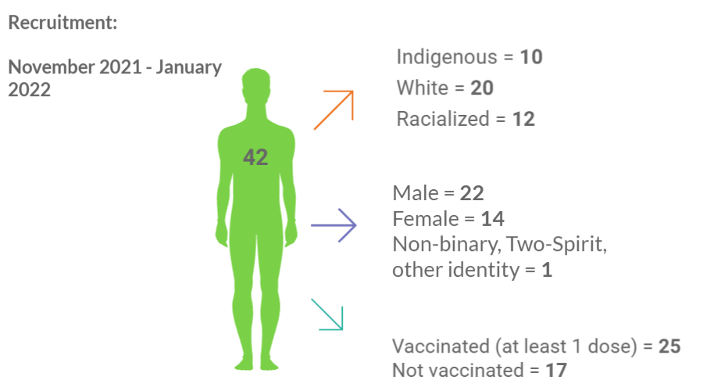
Qualitative Methods
Notes:
Jesse:
For the qualitative we recruited from among people who had already participated in the cohort study. In an attempt to include people with intersecting identities, which shapes peoples unique experiences in the social world, we used three categories to guide recruitment: race/ethnicity, gender and vaccination status. While we attempted to recruit relatively even numbers across all intersections of these three categories, things didn’t work out that way. From November 2021 to January 2022, we recruited 42 people into the study. Of the 42, 10 identified as Indigenous, 20 as White and 12 as Racialized; 22 identified as male, 14 as female, and 1 as non-binary; and 25 as vaccinated with at least one dose and 17 who were not vaccinated. Vaccination status was as of the baseline survey for the cohort study, but by the time we interviewed people, some vaccination statuses had changed.

Slide 13
We asked participants about…
Experiences during the COVID-19 pandemic
Opinions toward the COVID-19 vaccine
Enablers and barriers to vaccine uptake
Strategies to improve vaccine uptake
Sources of support, feeling safe and cared for
Notes:
Jesse:
We asked participants about
Their experiences during the COVID-19 pandemic
Their opinions toward the COVID-19 vaccine
Enablers and barriers to vaccine uptake
To identify strategies to improve vaccine uptake
And if they have had sources of support, if they felt safe and cared for during the pandemic
Some of these areas of exploration were chosen to expand on questions that the cohort survey asked people, as we realized there was a need for more depth to better understand these experiences and challenges.

Slide 14
Quantitative Findings
Notes:
Lucie:
While we just finished data collection recently and are preparing the final few interviews of data for analysis, we did run a few interim analyses that I’ll share now.

Slide 15
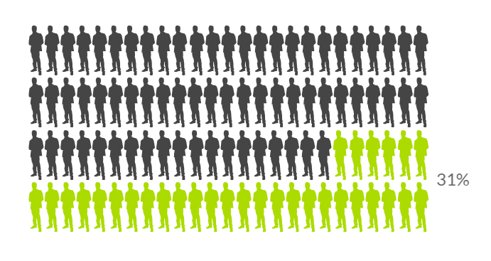
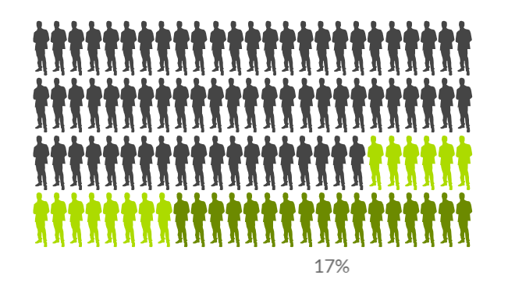
COVID-19 infection history at baseline
Notes:
Lucie:
In summer 2021, at the ‘baseline interview’, 224 out of 736 participants had a history of COVID-19 infection. Only 1 of these had active infection at the time of the interview.
Of these, only 126 (about 56% identified as having history of infection) knew about this history through PCR testing.

Slide 16
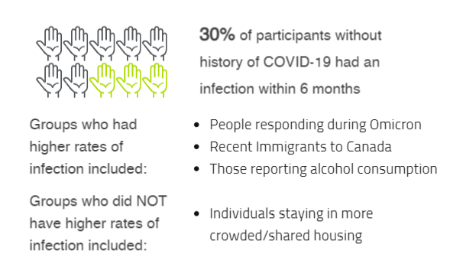
COVID-19 infection within 6 months
Notes:
Lucie:
Among people without history of infection at the baseline interview and who answered at least one of the 3 or 6 month interviews (which is what we had ready for analysis at the time), we found that 30% of individuals had become infected within 6-months, representing an average incidence rate of about 5.9% per month, or if we’re more interested in the rate since Omicron became dominant, about 11% per month, which is very high.
It’s obvious enough to everyone here that Omicron hit residents of homeless shelters and distancing hotels hard, so those reporting after this strain became dominant were much more likely to have evidence of infection; but there were other groups who also had higher rates, including individuals who immigrated to Canada in the past ten years and individuals who reported alcohol consumption in the past 3-months. Although housing-related exposure also showed expected trends (with more crowded/shared spaces being related to higher rates of infection), these differences were not significant. We think this might be because, at this point in the pandemic when so many have been exposed and infected through various means, looking at first-infections is no longer (if it ever was) a sensitive way to assess modifiable factors like housing-related exposure - we’ll need to look at the full burden of infection (so, first infections as we did here, but also re-infections, which are becoming more and more common) to see what if any role the environment has in infection burden. We’re working on that now.

Slide 17
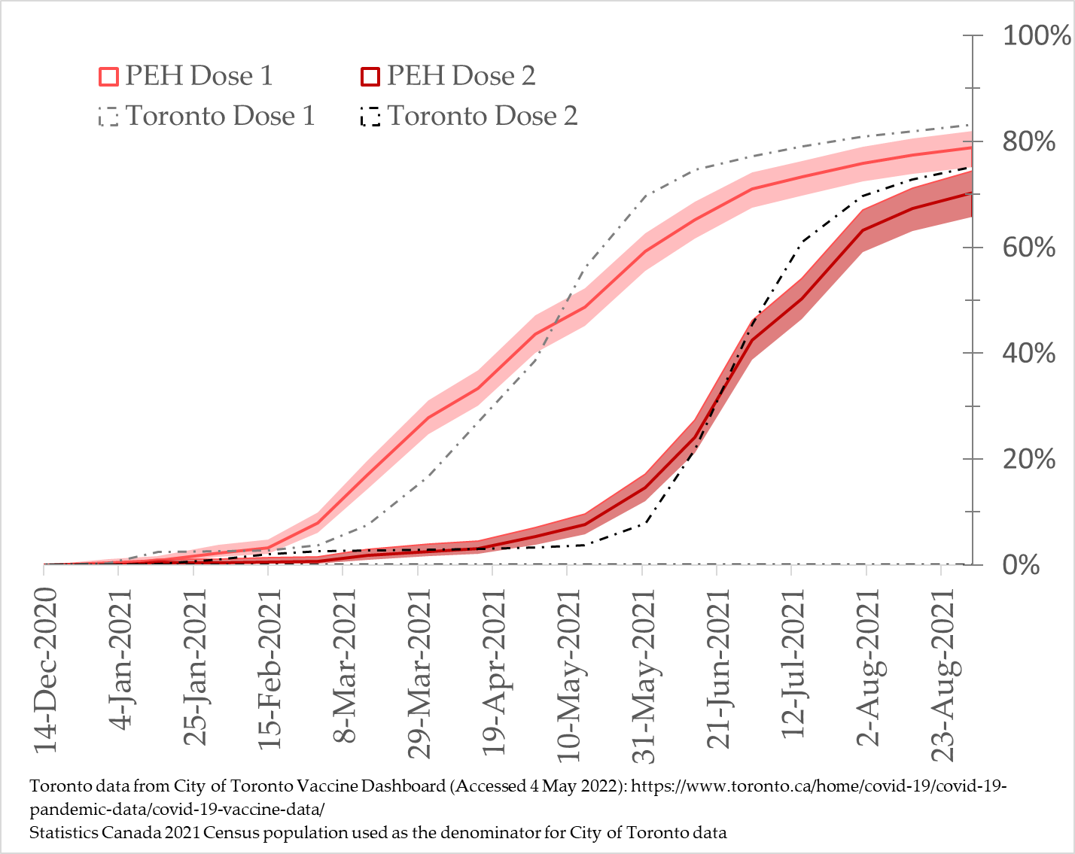
COVID-19 vaccination uptake
By September 2021:
80% of participants had 1+ vaccine dose;
64% had 2+ doses
Notes:
Lucie:
Finally we published an interim report about COVID-19 vaccination.
By summer 2021, 80% of participants had at least 1 COVID-19 vaccine dose, and 64% had 2 or more doses. This is a quite high rate, as you can see in the figure this is only slightly below that of adults in Toronto generally (the two dotted black lines). This rate is also much higher than most other reported groups of people experiencing homelessness to date, which signals that something, or more likely a series of somethings, in the Toronto vaccination effort went particularly well. That being said, we will in the follow-up be able to document what happened with regards to boosters (that is, 3rd and 4th doses), which are likely to be much lower.

Slide 18
Qualitative Findings
Notes:
Jesse:
As with the cohort study, these are initial, select findings.
An important contextual consideration for these findings is that we interviewed people after the vaccine passport had come into play. People also spoke a lot about their lives during the lockdown, as this had the most impact on them.

Slide 19
4. Experiences during the pandemic
  Accessing services
  Isolation and loneliness
  Stigma and discrimination
  Lack of social support
Notes:
Some had challenges accessing services like healthcare, social assistance, or even public spaces like libraries. Many doctors offices, drop-ins were closed to in-person appointments. This was challenging for those without access to technology to support virtual appointments. And for others, libraries and community centres were places they had frequented before lockdowns.
Many people spoke about isolation and loneliness. For some, this was not a new experience during COVID-19. They already felt isolated. This was hard to hear, but for some folks it created a buffer to the impacts of isolation and lockdowns, and was interpreted by some participants as a form of resilience. For others, the isolation exacerbated feelings of depression or sadness, and some coped by turning to substance use. I would like to highlight that this response to loneliness and isolation is not unique to people experiencing homelessness – many of us turned towards using substances in greater quantities during lockdowns that we previously had.
Some people spoke about ongoing stigma and discrimination that was exacerbated during the pandemic. People would actively avoid interacting with them on the street even more than they had previously.
Many felt that overall they had a lack of social support (friends, family, etc.). And some felt the government was supporting them well, especially with CERB, while others continued to struggle

Slide 20
“Now they’re a really nice bunch over there [at the shelter] and they try hard to be good to their clients but they have a policy that every day for at least four hours everybody has to leave so they can clean the place up ... Here we are right in the middle of it. You can’t go to a coffee shop, you can’t go to a library, you can’t go to a shopping mall…”
(ID_0498, Vaccinated, Male, Racialized)

Slide 21
“My alcoholism started to spiral out of control and [Pause] I think a lot of that has to do with the fact that I wasn’t seeing anybody you know everybody was sort of keep, like keeping their distance from everybody and [Pause] so I was very isolated so…”
(ID_3425, Vaccinated, Female, White)

Slide 22
5. Thoughts about COVID-19/government responses
  Abiding by PH rules/mandates (both V and NV)
  Vaccine passport as divisive
  Trust in science, understandable skepticism of the government
Notes:
Early in the pandemic the message was “we are all in this together”. People spoke of taking this seriously, of abiding by the public health mandates to protect themselves and those around them
When the vaccine passports came into effect, people felt a shift and those who were not vaccinated felt blamed for the pandemic; they felt like they had done what had been asked of them up until that point and were frustrated that they were further excluded from participating in social life
Many, both vaccinated and not vaccinated, had trust in science and the science of the vaccine, but had an understandable skepticism of the government. We can speak to this important piece in the Q and A in more detail.

Slide 23
“I try to keep myself safe as much as I can. I do not interact with nobody like I’m in my room most of the time. I try to keep myself safe. I have my mask on anytime to move around the building I have my mask on, I sanitize so, yeah, I try.”
(ID_1535, Not Vaccinated, Female, Racialized)

Slide 24
“… now they’re only allowing the vaccinated to go out. Well, what about the unvaccinated? … What are we supposed to do? You know we can’t go out now. We can’t go and have fun. Why can’t you have facilities where it’s just strictly for unvaccinated people? You know like why can’t they make that fair where now we have to do everything virtual and still stay by ourselves and you know like that’s still pointless. We’re still going to be depressed, we’re still going to want to do stuff that we’re not supposed to.”
(ID_0095, Not Vaccinated, Female, White)

Slide 25
“I trust the science. I trust the doctors; I trust the scientists. I don’t normally trust the government [laugh] but I trust, I trusted the doctors and I really believed that it was going to be okay.”
(ID_3425, Vaccinated, Female, White)

Slide 26
6. Forces shaping vaccine decision making
  Access
  Vaccine trust
    Hasn’t been around long enough, safety, effectiveness
    Vaccination as normative behavior, protecting the gen pop
  Experience getting vaccinated
    Supported, questions answered
    Rushed
  Agency
Notes:
The things that shaped vaccine decision making the most were access, vaccine trust, their experience getting vaccinated, and considerations around agency.
Many vaccine clinics were set up inside shelters, which was seen to really help people who were unsure where to access the vaccine or for those who travelling to get the vaccine was not a main priority
Some saw vaccination as normative behavior and that they were protecting the general population and themselves
Others were worried about the vaccine, saying it hadn’t been around long enough to know the long-term effects, they were not clear on its safety for them personally, and they were unclear about its effectiveness in preventing COVID-19 transmission. This definitely points to some challenges around the different PH messaging that came out on the purpose of vaccination – to prevent transmission or prevent serious illness.
Some people felt that having vaccine clinic staff come to the shelter in advance of the clinic to ask questions was a helpful strategy as it meant they didn’t feel rushed or pressured to get vaccinated on the spot, and could ask important questions they had
Many felt that vaccination was an issue of agency, decision-making power over their body. This is an incredibly important point, as many people experiencing homelessness are told where to sleep, when to leave a shelter, have different rules they are told to abide by, and in these ways are less able to exert agency in other realms of their life.

Slide 27
7. Strategies to improve government responses, vaccination rates
  Education and information sharing
  Peer ambassadors
  Personalized approach
  Sticks, Carrots and Breaking Barriers
    Mandates, incentives, improving access
  Holistic approach to dealing with PH crises – HOUSING, SERVICES
Notes:
People spoke about multiple strategies to improve both government responses to public health crises and vaccination rates.
First, people needed education strategies and information that was relevant to them. For instance, many people used to get news from TV stations playing in cafes, which were now closed. Some shelters had great information handouts, while this wasn’t as widely available in others. People also needed to hear information relevant to their circumstances. Being told to physically distance was near impossible for people living in shelters that had not yet had their capacity reduced to facilitate this.
People spoke about the benefit of having peer ambassadors. People living in the shelters who could share relevant information, share their experiences getting vaccinated, etc. without pressure.
Many spoke of the need for a personalized approach. For instance, those who didn’t have a PCP, a family doctor, felt they didn’t have anyone to ask about how the vaccine or COVID-19 might impact them, with their unique health considerations.
People also spoke about things I categorized into Sticks, Carrots and Breaking Barriers: Some suggested mandates were the only way to get more people vaccinated. Some people we spoke to only got doses 1 and 2 because of the vaccine passports but had no intention of continuing with boosters. Some said incentives, especially monetary ones, were key. Others said incentives were suspect, but ultimately these were valued.
Access to vaccines was, largely, quite impressive. Vaccine clinics rolled out across all shelters and many people said this was a main reason they were able to access the vaccine. So Toronto really did a great job with that.
Lastly, nearly everyone stressed the need for a more holistic approach to dealing with a PH crisis. People need housing, so they can protect themselves and be safe, and they need access to services. Lockdowns really were hard on many people, and so we need to think through these important considerations in our PH responses so we don’t further marginalize and oppress people who are often pushed to the margins of society.

Slide 28
“My own personal opinion with this pandemic is it really adversely affected the lower economic classes more than the wealthy class ... You know so who really suffered the brunt was the lower economic classes and then the ones, the homeless which are right on the bottom. It was like a kick in the teeth.”
(ID_0498, Vaccinated, Male, Racialized)

Slide 29
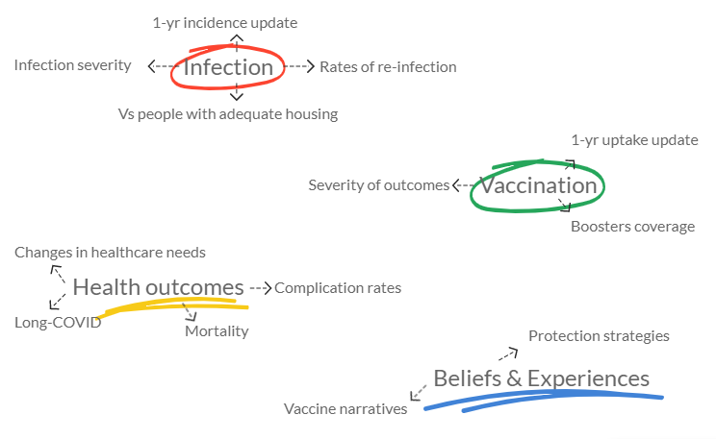
Don’t see it here? Tell us what other questions you’d like us to answer!
Notes:
We have much yet to learn with this data, and now that we’ve completed data collection and are getting the final datasets ready we have a whole suite of research questions we hope to address with both the cohort and qualitative data. The figure here just highlights some key topics we plan to address.
That being said, we very much want to incorporate feedback and suggestions regarding both what we do and how we do it. Please fill out the feedback form, and don’t hesitate to reach out to us if you have any ideas or suggestions. You can reach out during the upcoming Q&A, or approach us sometime during the conference, or even by email later on.

Slide 30
For more information, please see:
Protocols (these detail data collection and analysis methods):
Richard L, Nisenbaum R, Liu M, et al. Ku-gaa-gii pimitizi-win, the COVID-19 cohort study of people experiencing homelessness in Toronto, Canada: a study protocol. BMJ Open 2 2022; 12: e063234. doi:10.1136/bmjopen-2022-063234
Jenkinson JIR, Sniderman R, Gogosis E, et al. Exploring COVID-19 vaccine uptake, confidence and hesitancy among people experiencing homelessness in Toronto, Canada: protocol for the Ku-gaa-gii pimitizi-win qualitative study. BMJ Open 2022; 12:e064225. doi:10.1136/bmjopen-2022-064225
Website:
https://maphealth.ca/ku-gaa-gii-pimitizi-win/
Notes:
For those of you who like me have a burning need to know more about how things were done, we did publish protocols for both the cohort and qualitative studies. Here are the citations for them. You can also check out our webpage on the MAP website.

Slide 31
Lucie Richard
Lucie.Richard@unityhealth.to
Jesse Jenkinson
Jesse.Jenkinson@unityhealth.to
Notes:
And here are our emails, in case you’d like to reach us with any questions, suggestions or feedback. Thank you!

Slide 32
Discussion / Q&A

Slide 33
Ku-gaa-gii pimitizi-win:
Lessons learned from conducting a cohort study measuring incidence and
prevalence of COVID-19 among people experiencing homelessness in Toronto
Olivia Spandier, Dr. Sharmistha Mishra, Allison Dyer & Frank Crichlow
November 2nd 2022
This research was supported by the Canadian Institutes of Health Research (CIHR) (FDN-167263 and GA3-177721), and by the Canadian Institutes of Health Research (CIHR) (VR5-173211) in partnership with the Public Health Agency of Canada, through the COVID-19 Immunity Task Force (CITF).
Notes:
Lessons learned re: data collection, what mathematical modelling can teach us about future pandemics, and what we have learned about working with and supporting researchers with lived experience.

Slide 34
Part 2:
Data collection: Lessons learned
Notes:
Olivia

Slide 35
Recruitment
736 participants recruited over 3 months from 61 shelters and physical distancing hotels; follow-ups each 3 months for a year
Participants were approached based on a predetermined random order
Notes:
Just to remind folks, we recruited…

Slide 36
In-person surveys conducted on IPADS and saliva and blood samples were collected to test for present and past COVID-19 infection
Interviewers were screened at each site and wore full PPE, while participants were given a mask and offered hand sanitizer

Slide 37
Navigating Data Collection
Change in unit numbering system – the system within which we were working was adapting to COVID-19
  New numbering systems to ensure physical distancing
  Staff called to confirm numbering system the day before site visits

Slide 38
Developing trust
  Provided notification of study, posters at sites
  Had shelter staff assist with first contact so that it was a familiar face
  Relationship building and providing resources
Outbreaks prevented site visits
  Ensured research staff had access to vaccines and N95s
  Cleared to visit sites

Slide 39
Participants moved and or were discharged and not able to go back to their original interview site
  Interviewers obtained detailed contact information on participants and contacts
  Developed relationship with Bond Place, Heyworth House and Good Shepherd to interview participants not currently residing there
  If consented, used SSHA reports to find out where they were staying
  Letters for participants left at sites if they were not present

Slide 40
Access
  Used a call-in translation service
  We travelled to participants and performed home visits and outreaches to increase accessibility for all participants
  Met people in their location of choice (ie. park, mall, coffee shop)
  Option of accessible sites for interviews
  Coordinated with detention centers to arrange transportation to and from interviews

Slide 41
Part 3:
Mathematical Modelling

Slide 42
Mathematical models can be used to:
Project what might happen next
Explain why something happened
Compare the potential benefits of different strategies and policy decisions
Identify what data are needed to generate more accurate answers

Slide 43
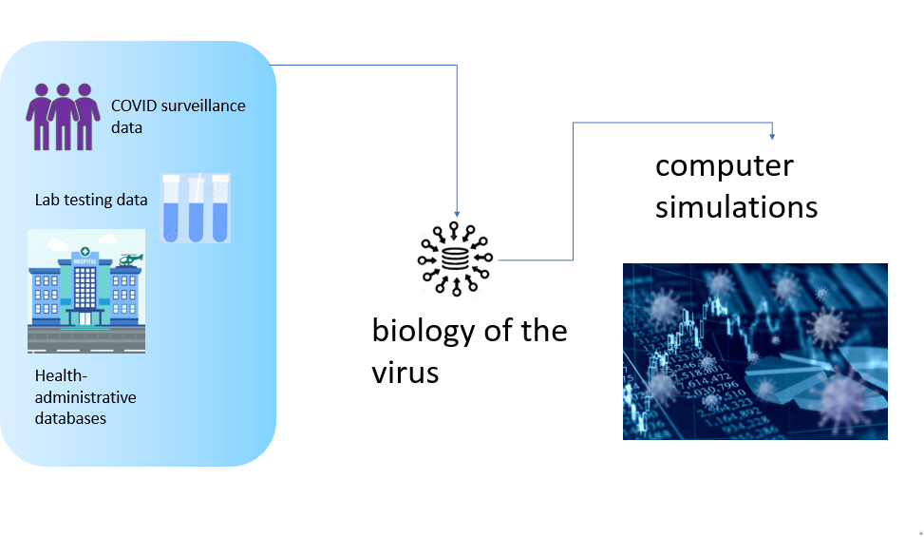
Data on Cases

Slide 44
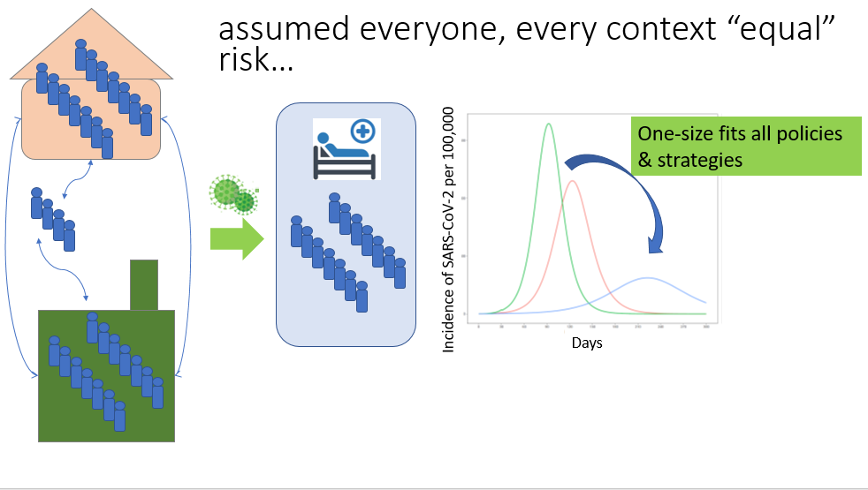

Slide 45
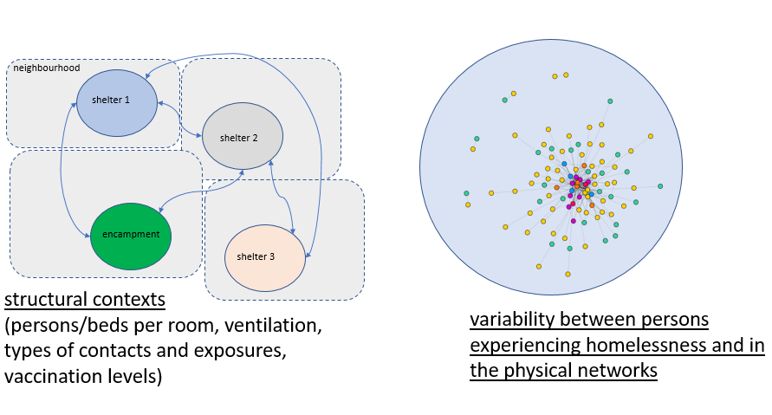
A new mathematical model

Slide 46
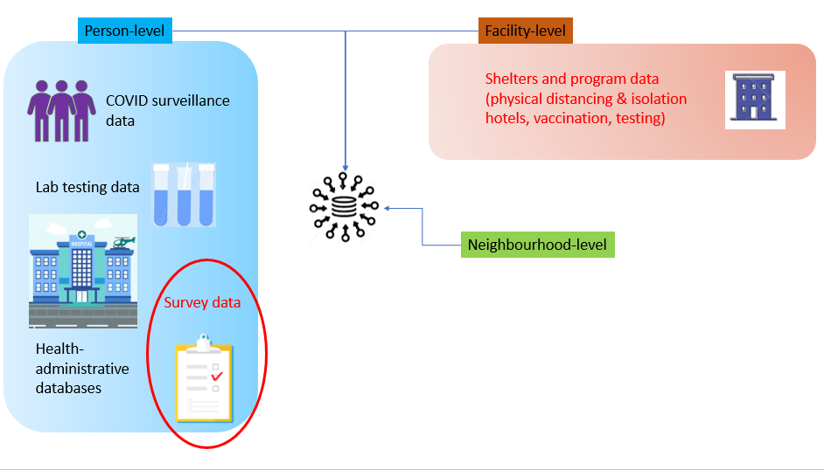

Slide 47
Put numbers to…
Past
  How many cases were prevented to date with the strategies put into place?
Future
  Risk of future outbreaks if status quo remains?
  Size of future outbreaks if status quo remains?
  What strategies could minimize risk of future outbreaks?
  What pre-pandemic or inter-pandemic policies could minimize risk of future outbreaks?
Support advocacy
Inform policies

Slide 48
Sharmistha Mishra
Sharmistha.Mishra@utoronto.ca
Huiting Ma
Huiting.Ma@unityhealth.to

Slide 49
Part 4:
Researchers with Lived Expertise: Guidance and Next Steps

Slide 50
Proverb
What we do for ourselves dies with us, but what we do for others and the world remains and is immortal.
Notes:
Frank

Slide 51
What do researchers with lived expertise bring to the research team? Why are we important?
Notes:
Allison:
As a person with lived expertise, I enter spaces with participants with a familiarity and contextualized understanding of how an experience is shaped in and out of the systems and social structures we exist in.
For example, I can understand the emotional labour it asks of us to move between different spaces in the City, to access different services, all in an attempt to create stability for ourselves.
As a member of a research team, my interests are calling attention to things that occur in daily life but are not reflected in policy or operational practices. For example, early in the pandemic some shelters took away access to their public telephones for fear of COVID-19 transmission. This cut off access for many residents.
Frank:
Researchers with lived expertise bring our knowledge, our strength, our voices to a team.
We as people with lived expertise have to be respected, have to be treated as equals and our voice must be heard.

Slide 52
What needs to improve in research?
Pay equity and job security
Professional development – investing in people’s careers
Language and identity
Access to opportunities
  Accessibility vs advocacy
  (being involved in the research) vs (being authentically heard)
Notes:
Allison

Slide 53
Pay Equity
and
Job Security
Notes:
Frank:
Research is a warped system.
We have very little job security:
We work in short-term contract positions. Even if the contract says 9 months, it can be terminated at any time.
We have no guarantee we will see the project through to the end, the final stage.
We don’t get equitable pay, vacation or benefits.
Who gets the tap on the shoulder? The researchers. We don’t always get acknowledged.
We help bolster up a team, and then the lead researchers gain the benefit (through networking, opportunities, bigger grants).
However, the TEAM is supposed to be complimented.
People with lived expertise invest time and energy and deserve to be acknowledged.

Slide 54
Professional Development
Notes:
Allison:
Research teams need to invest in our professional development. Our lived experience is more useful when we have the training and tools to understand how our experience can inform research. We need mentorship to develop the skillset to decipher and analyze the practices that surround us. Beyond being hired into a team, we need training in and above the current research role so, as researchers, we grow and have longevity in this field.

Slide 55
Language
and
Identity
Notes:
Frank:
Communication
- My deepest concern is that researchers miscommunicate our language, and write things in a language that is difficult for us to understand. Then we have to go back to the researcher and ask “what do you mean by this?”
Identity
Across Canada, we don’t have a universal language for how we refer to or call researchers who have lived expertise. In some places, the word “peer” is used. Here, I find the word “peer” stigmatizing.
I don’t call myself a Peer. I consider myself to be a research associate, for lack of a better word. The reason is because we are doing the same thing that you guys are doing – knowledge translation, and therefore I cannot call myself a peer.
We are not considered staff, we are often not respected.

Slide 56
Access to Opportunities
and
Advocacy
Notes:
Allison:
There is a problem in the recruitment process of hiring lived expertise researchers. In my experience, and in discussion with my peers, we have realized the roles are largely filled by internal networks. Though this may be efficient, it is not truly a diverse pool of candidates. The only difference between a lived expertise researcher and a participant is awareness of research opportunities as employment, training in research, and where we are in our journey. Anyone can start from anywhere. There needs to be a better system when it comes to hiring researchers with lived expertise.
Once a lived expertise researcher is hired we need our voices to be authentically heard. We need our language and our defined terms to be reflected in manuscripts. For example, not what a largely recognized organization says homelessness is, but how it is defined by us, the broader group of people experiencing homelessness.

Slide 57
Call to Action
Notes:
For research teams to improve their meaningful inclusion of researchers with lived expertise of homelessness.
For Researchers with Lived Expertise to advocate for their role and expansion of their role.

Slide 58
Discussion / Q&A

Slide 59
Thank you!

